Slide 1

Stock Price Prediction Report
Name:- Neeraj Kumar Singh
Enrollment:- E23CSEU0792

Slide 2
Introduction
Stock price prediction plays a vital role in financial markets, helping investors make informed decisions by forecasting future trends. The objective of this project is to predict the future stock prices of publicly traded companies using historical market data. By analyzing patterns in stock price movements over time, we aim to build accurate machine learning models that can learn temporal dependencies and trends. This project leverages time-series forecasting techniques, such as Long Short-Term Memory (LSTM) networks, to provide predictive insights. The ultimate goal is to enhance investment strategies and minimize risk through data-driven stock price forecasting.

Slide 3
Problem Statement
The goal is to predict the future closing price of a selected stock, such as Apple Inc. (AAPL), using historical data.
We utilize time-series forecasting models to capture trends and temporal dependencies in stock price movements.
The project focuses on univariate analysis, primarily using the closing price as the main feature.
Advanced models like LSTM neural networks are applied for more accurate forecasting compared to traditional methods.
Model performance is evaluated using error metrics including RMSE, MAE, and MSE to determine prediction accuracy.

Slide 4
Dataset Description
Source: Historical stock data was obtained from Yahoo Finance, a reliable platform for financial information.
Stock: The dataset focuses on Apple Inc. (AAPL), one of the most actively traded stocks.
Time Range: Data spans from January 2010 to December 2023, providing over 13 years of stock activity.
Features: Includes Date, Open, High, Low, Close, Adj Close, and Volume, capturing daily market details.
Frequency: The data is recorded at a daily interval, suitable for training time-series forecasting models.

Slide 5
Data Preprocessing
Handling Missing Values: Any missing data entries in the dataset were handled using the forward-fill method, ensuring continuity in the time series without introducing noise
.
Feature Selection: For univariate prediction, only the ‘Close’ price was selected as the target feature, simplifying the modeling process.
Scaling: The selected data was normalized using Min Max Scaler, scaling values to a range between 0 and 1 to improve model convergence.
Windowing: A sliding window approach was used, creating input sequences of 60 days to predict the next day's price.
Data Formatting: The sequences were reshaped to match LSTM input format.

Slide 6
Training Details
Train/Test Split (80/20): You are splitting the data into 80% for training and 20% for testing. This is a common practice to ensure that the model has enough data to learn from while also leaving a portion to evaluate its performance.
Epochs (50–100): You will train the model for between 50 to 100 epochs. This allows for enough learning but ensures you're not overfitting by training too long.
Batch Size (32): You’re using a batch size of 32. This means the model will update weights after processing 32 samples in one go. It's a good trade-off between memory efficiency and training time.
Early Stopping: You have early stopping enabled to monitor the model's validation loss (or another metric). If the model's performance on the validation set stops improving (or starts to deteriorate) over a set number of epochs, training will stop early to avoid overfitting.

Slide 7
Evaluation Metrics
MSE (Mean Squared Error):
Formula:
MSE=1n∑i=1n(yi−y^i)2MSE = \frac{1}{n} \sum_{i=1}^{n} (y_i - \hat{y}_i)^2MSE=n1​i=1∑n​(yi​−y^​i​)2
Purpose: MSE penalizes larger errors more heavily, as it squares the difference between the actual and predicted values. It's a common metric for regression tasks.
Interpretation: A lower MSE indicates better model performance.
RMSE (Root Mean Squared Error):
Formula:
RMSE=MSERMSE = \sqrt{MSE}RMSE=MSE​
Purpose: RMSE gives a measure of the average error magnitude in the original units of the target variable, making it easier to interpret compared to MSE.
Interpretation: A lower RMSE suggests better predictive accuracy, and it is typically more interpretable than MSE because it has the same units as the target variable.

Slide 8
MAE (Mean Absolute Error):
Formula:
MAE=1n∑i=1n∣yi−y^i∣MAE = \frac{1}{n} \sum_{i=1}^{n} |y_i - \hat{y}_i|MAE=n1​i=1∑n​∣yi​−y^​i​∣
Purpose: MAE measures the average of the absolute errors. It's more robust to outliers than MSE because it doesn't square the differences.
Interpretation: A lower MAE indicates better model accuracy, and like RMSE, it's easier to interpret since it's in the same units as the target variable.
R² Score (Optional):
Formula:
R2=1−∑i=1n(yi−y^i)2∑i=1n(yi−yˉ)2R^2 = 1 - \frac{\sum_{i=1}^{n} (y_i - \hat{y}_i)^2}{\sum_{i=1}^{n} (y_i - \bar{y})^2}R2=1−∑i=1n​(yi​−yˉ​)2∑i=1n​(yi​−y^​i​)2​
Purpose: R² measures the proportion of the variance in the dependent variable that is predictable from the independent variables. It gives a sense of how well the model fits the data.
Interpretation: R² ranges from 0 to 1. A score closer to 1 indicates a better fit, while a score close to 0 indicates that the model is not capturing the variance in the data well. If the model's R² score is negative, it suggests that the model is worse than simply predicting the mean value of the target variable.

Slide 9
Visualizations
Line Plot of Actual vs. Predicted Closing Prices:
This will help you visually assess how well your model's predictions align with the actual values. A perfect prediction would result in a plot where the actual and predicted values are identical
Loss Curve During Training:
This plot helps visualize how the loss (or error) decreases over the training epochs, which indicates whether the model is converging and learning. A steady decrease is ideal, while fluctuations might indicate overfitting or other issues.
Rolling Window of Prediction Errors (Optional):
This is useful to examine how the prediction errors change over time. You can apply a rolling window to smooth out the error curve and make trends easier to identify.

Slide 10

Model Accuracy

Slide 11
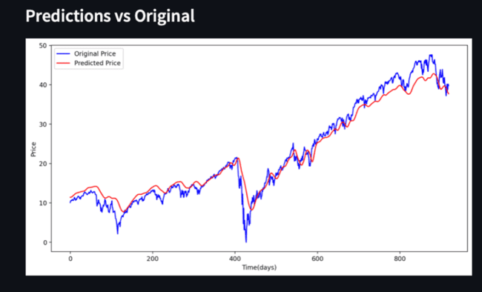
Model Accuracy

Slide 12
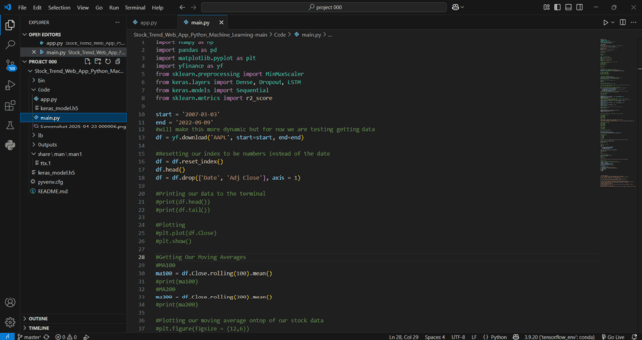
Code

Slide 13
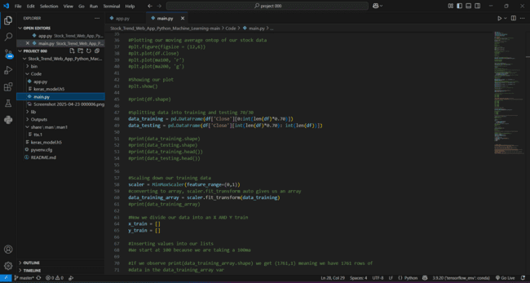
Code

Slide 14
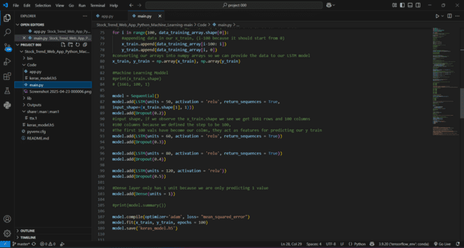
Code

Slide 15
Conclusion
The LSTM model outperformed traditional models like ARIMA, primarily due to its ability to capture long-term sequential dependencies in stock price data. Unlike ARIMA, which relies on linear assumptions and historical trends, LSTM leverages memory cells to retain important patterns over time, making it more suitable for complex, non-linear time series forecasting. However, there is still room for improvement. Enhancing the model with additional features such as sentiment analysis from financial news, social media trends, and technical indicators like RSI or MACD could provide richer context and further boost prediction accuracy and robustness in dynamic market conditions.

